Slide 1
非遗文化系列课程（6）—— 共享篇
微课宇宙队

Slide 2
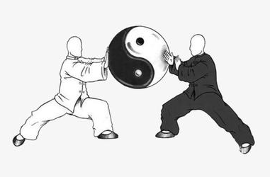
Tai Chi 太极拳

Slide 3
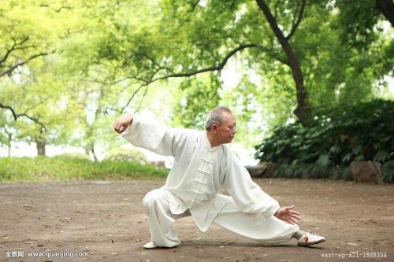
Morning Exercise 晨练

Slide 4
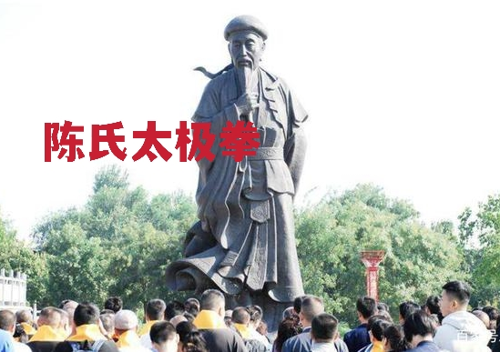
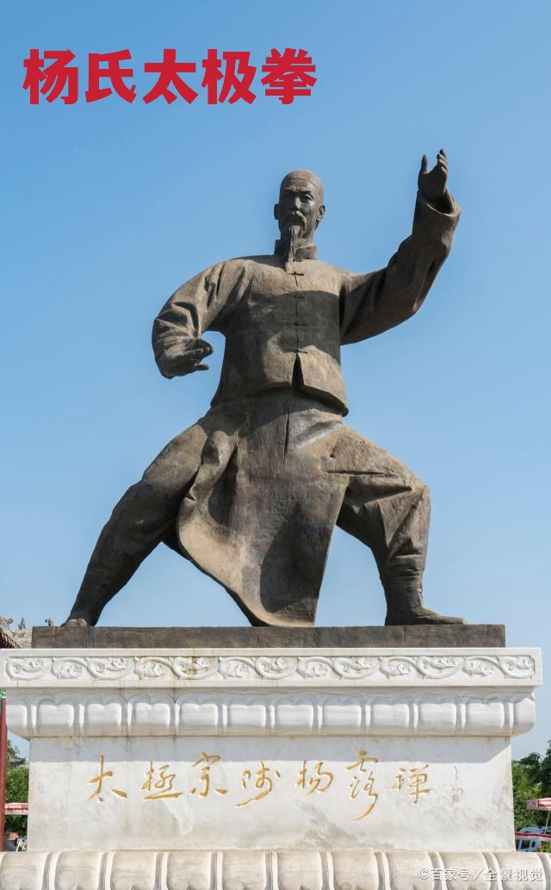
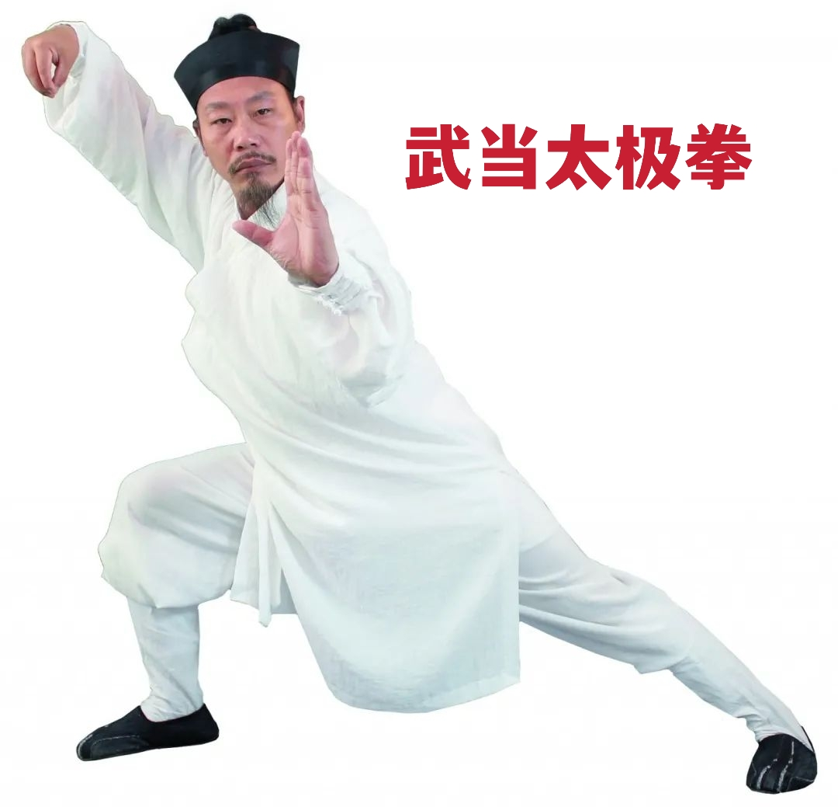

Slide 5
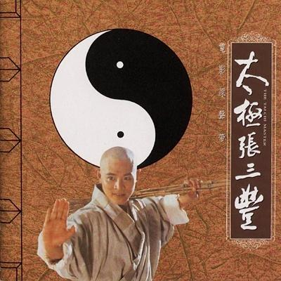
Tai Chi Master

Slide 6
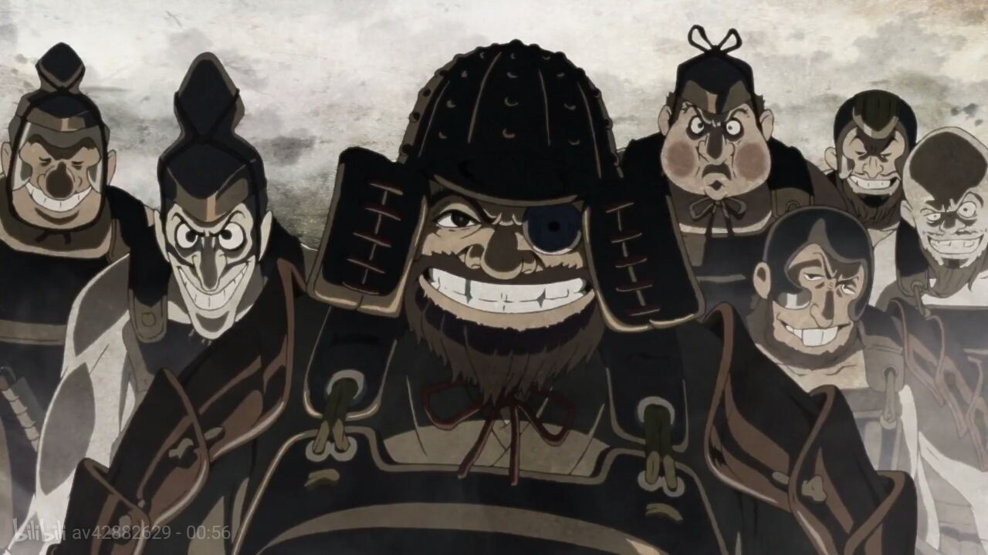
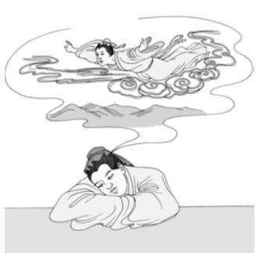
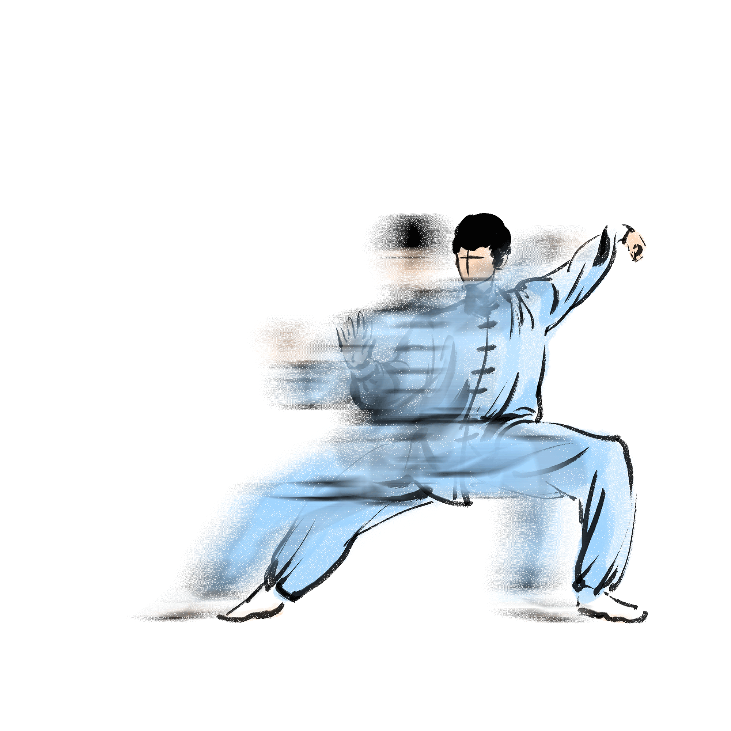

Slide 7
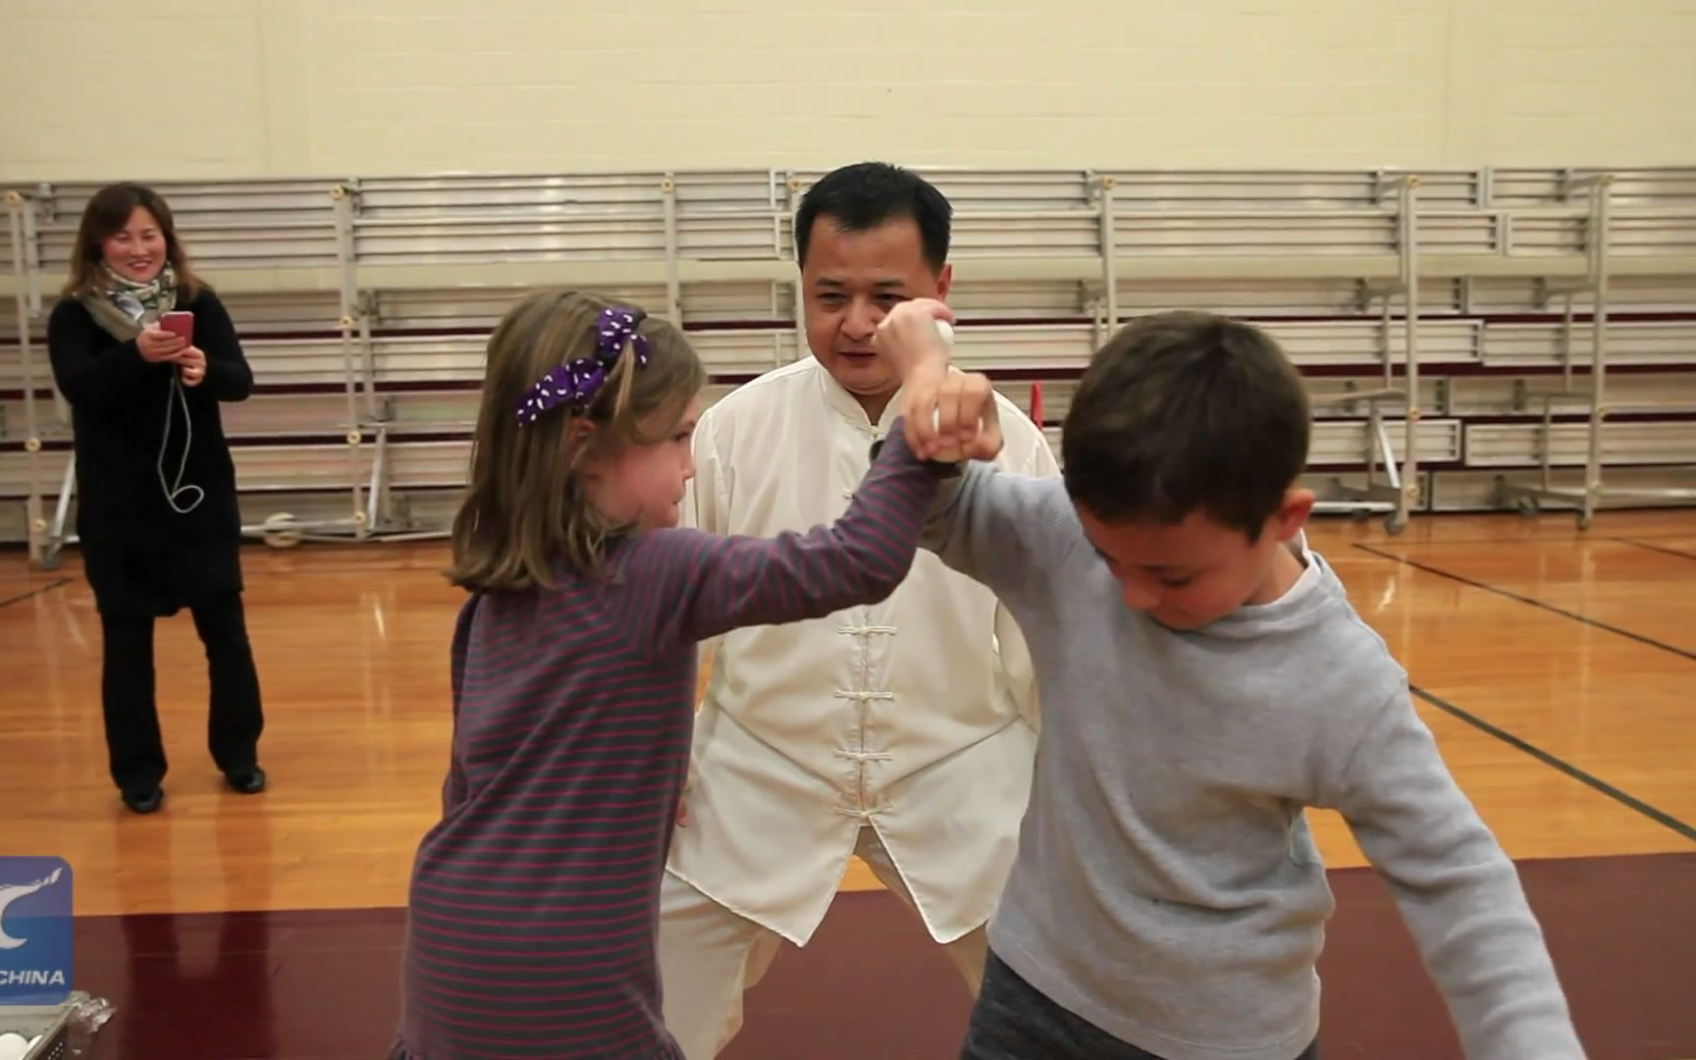
Popular Fitness Program
受欢迎的健身项目

Slide 8
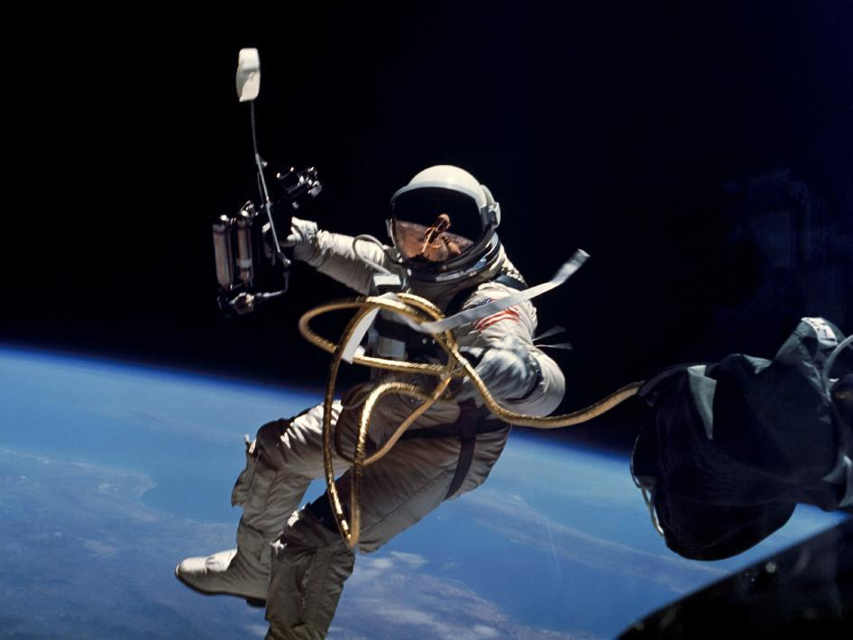
Regular Training Program
定期训练项目

Slide 9
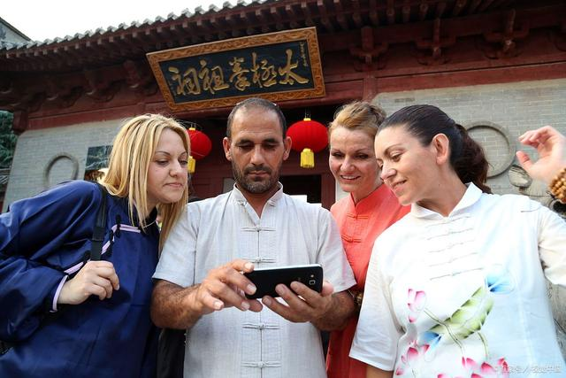
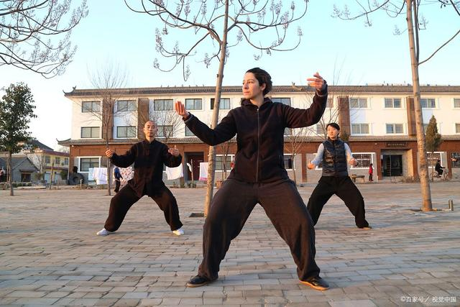
Come here attracted by its reputation and learn skills from masters
慕名而来 拜师学艺

Slide 10
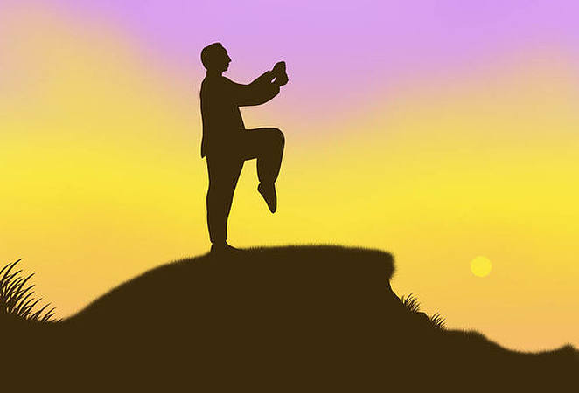
Chinese kung fu and Chinese culture
中国功夫与中国文化

Slide 11
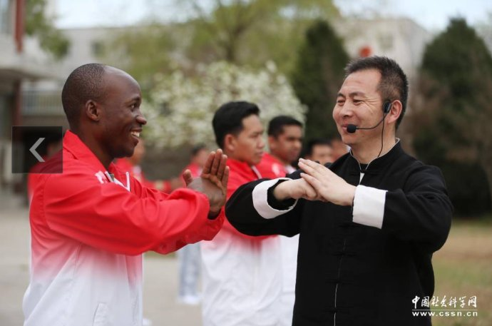
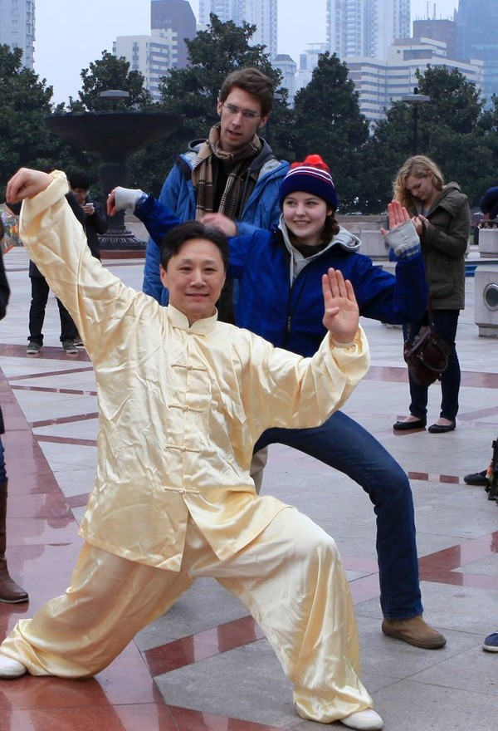
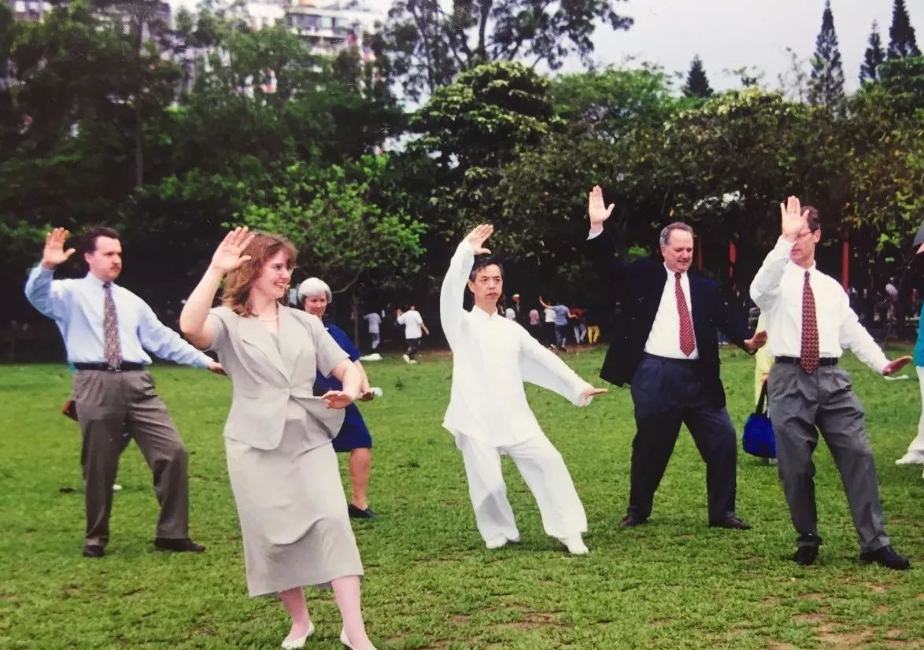
Cultural Sharing
文化共享

Slide 13
Questions
思考
Do you know any other Chinese culture which is globally shared？
同学们，你们还知道哪些中国文化走向了世界呢？

Slide 14
谢谢观看!
Thank you!

