Slide 1
非遗文化系列课程（5）—— 乡愁篇
微课宇宙队

Slide 2
乡愁 Homesickness
余光中
小时候
When I was a child
乡愁是一枚小小的邮票
my homesickness was a small stamp
我在这头
I was here
母亲在那头
my mother was there
长大后
After growing up
乡愁是一张窄窄的船票
my homesickness was a narrow ticket
我在这头
l was here
新娘在那头
my bride was there
后来啊
Later
乡愁是一方矮矮的坟墓
my homesickness was a little tomb
我在外头
I was outside
母亲在里头
my mother was inside
而现在
And now
乡愁是一湾浅浅的海峡
my homesickness is a shallow strait
我在这头
I am here
大陆在那头
the mainland is there

Slide 3
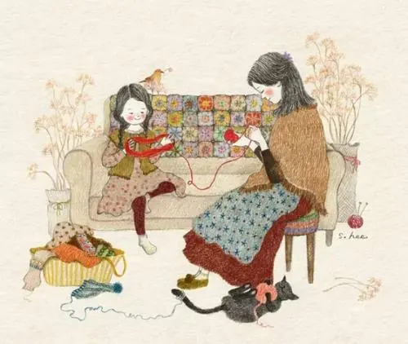
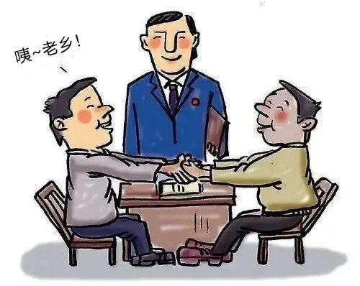
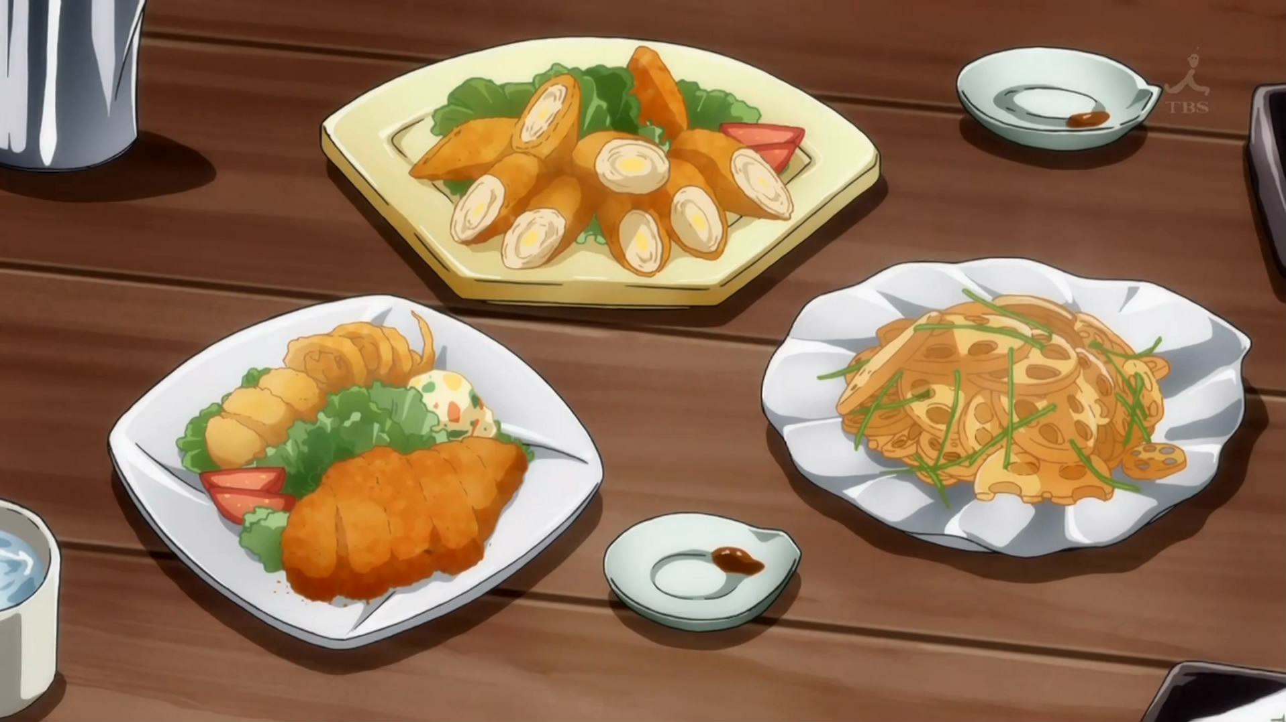

Slide 4
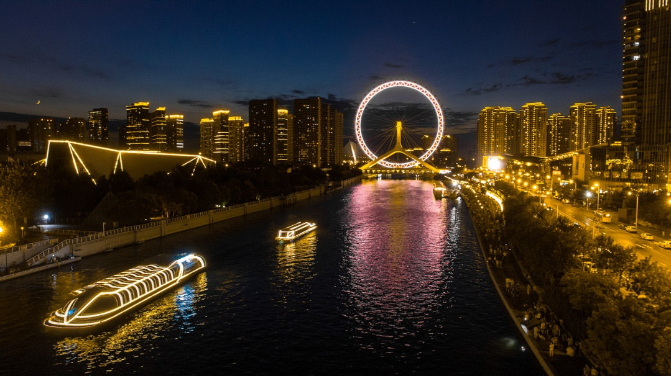
Tianjin
天津

Slide 5
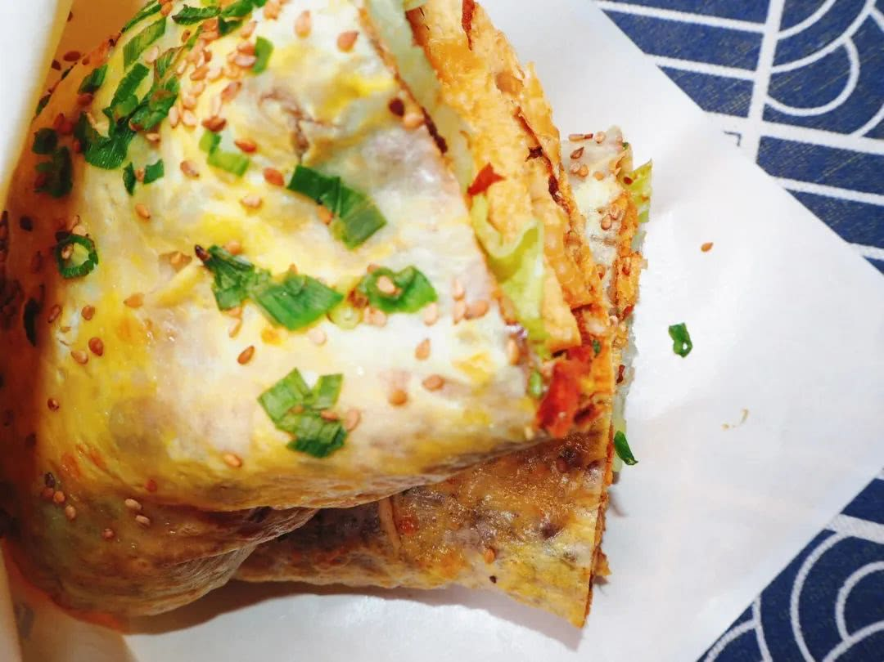
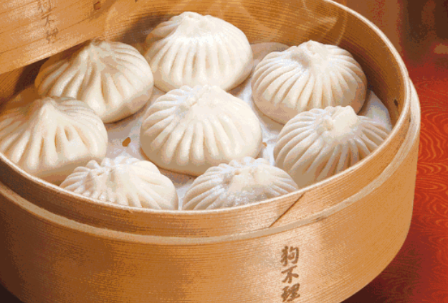
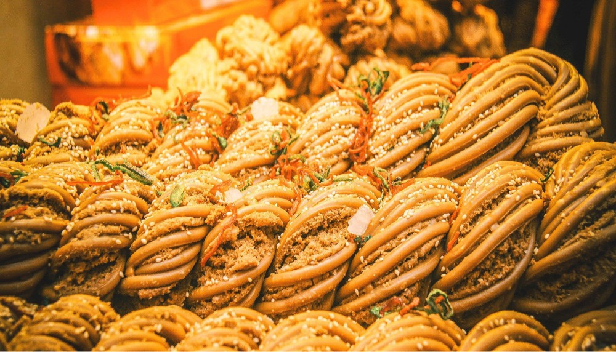
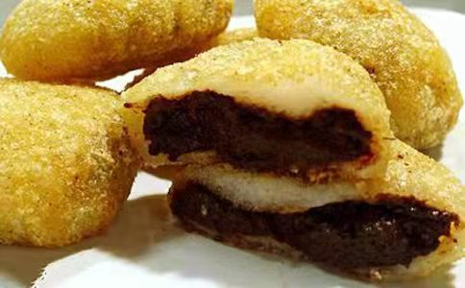
Delicious food in Tianjin
天津美食
Jianbing 煎饼馃子
Goubuli 狗不理包子
Fried dough twist 麻花
Erduoyan 耳朵眼炸糕

Slide 6
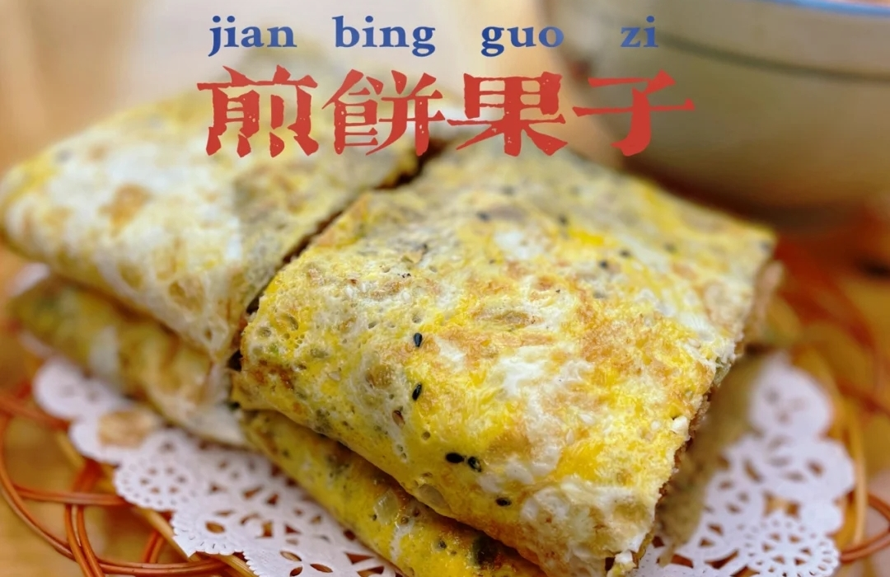
Jianbing， pancake rolled with crisp fritter

Slide 7
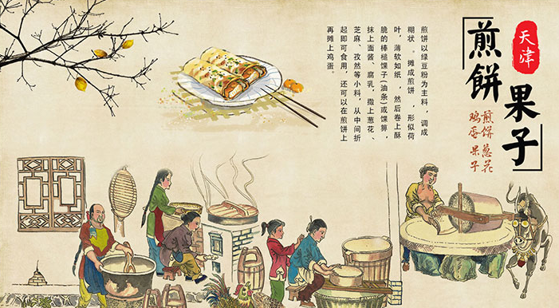

Slide 8
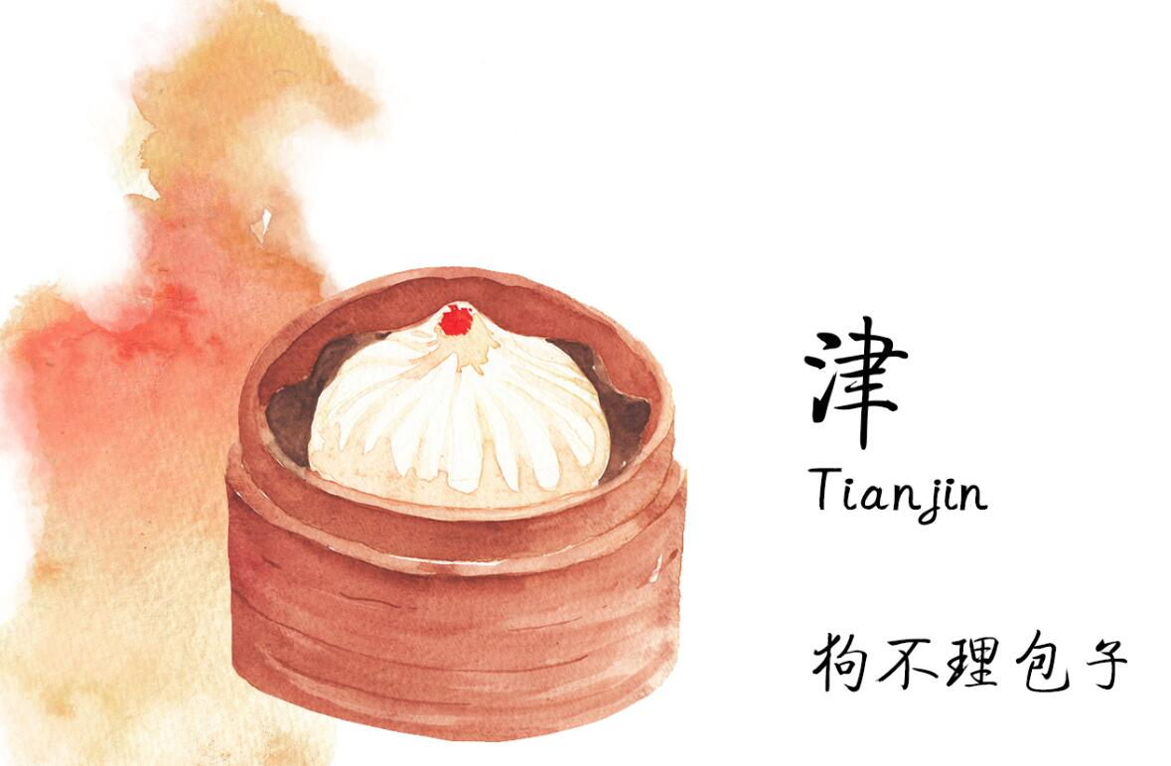
Goubuli steamed bun

Slide 9
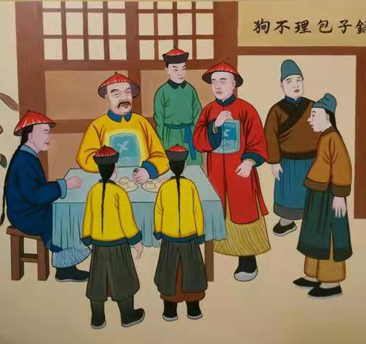
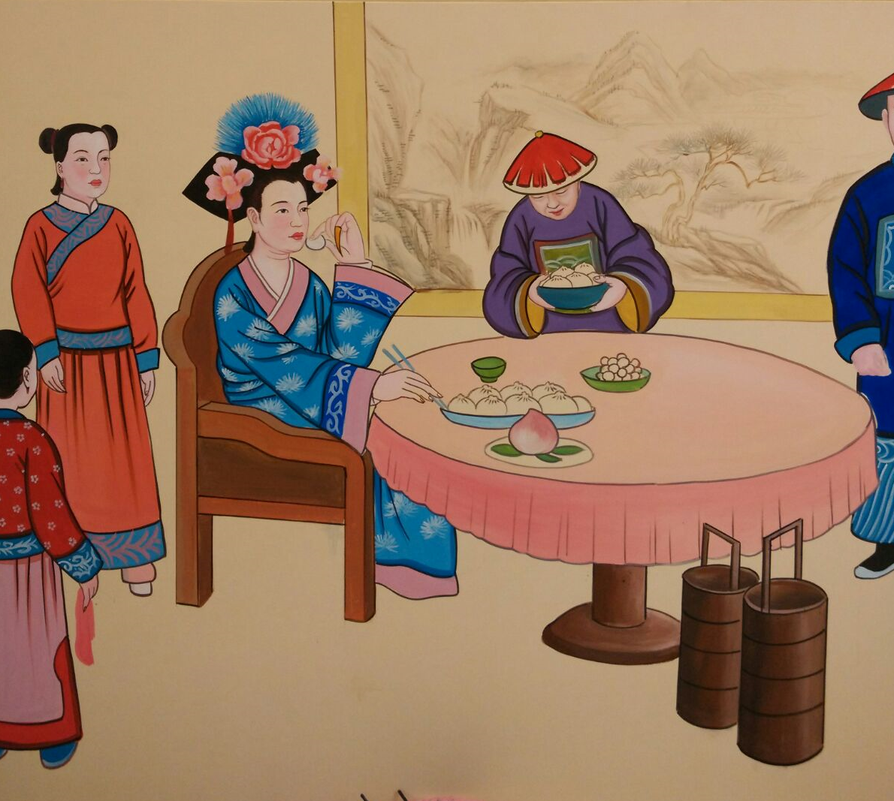

Slide 10
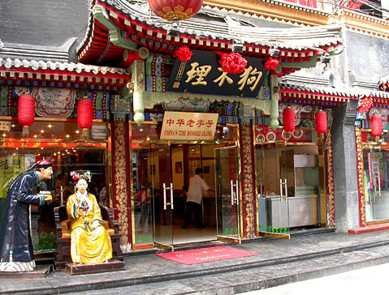
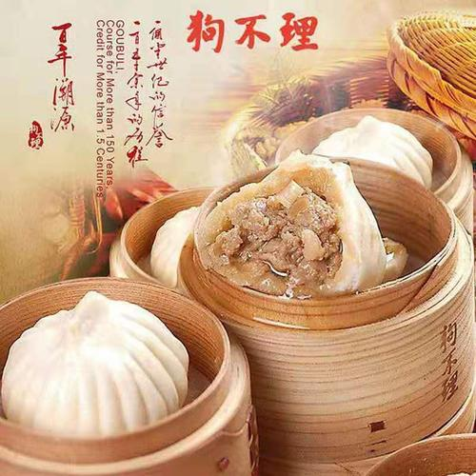

Slide 11
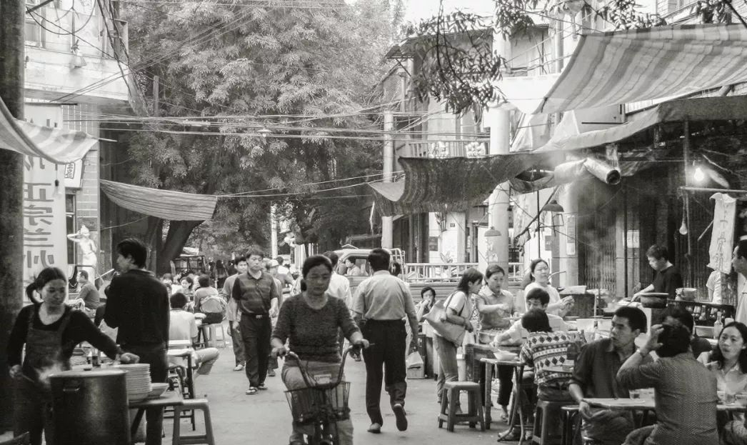
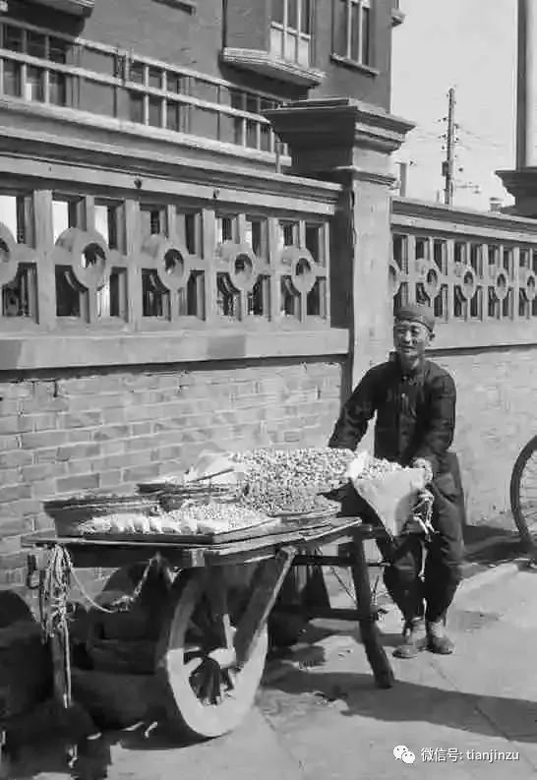
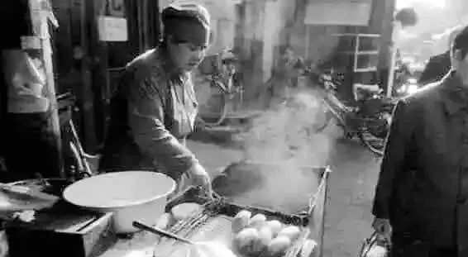

Slide 13
Questions
思考
Are there any special and unforgettable foods
in your hometown?
你的家乡有什么特色的、难以忘怀的美食吗？

Slide 14
谢谢观看
Thank you

