Slide 1
非遗文化系列课程（1）——家文化篇
微课宇宙队

Slide 2
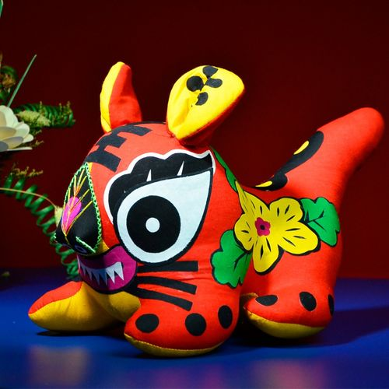
我的姐姐即将生下一个可爱的宝宝，所以我准备了布老虎作为礼物。 My elder sister is going to give birth to a cute baby, so I prepared the Cloth Tiger as gifts.

Slide 3
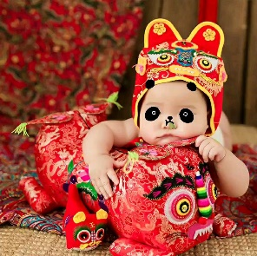
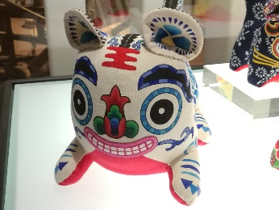
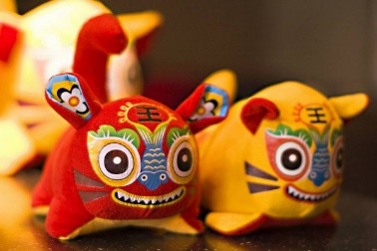
布老虎的用处
Its functions:
布老虎是一种传统工艺品，它的种类很多，流传也很广泛，在中国有很长的历史。Cloth Tiger is a traditional craft with various kinds. It is widely spread and has a long history in China.
儿童玩具
toy
礼品馈赠
give gift
个人收藏
personal collection
室内摆设
indoor decoration

Slide 4
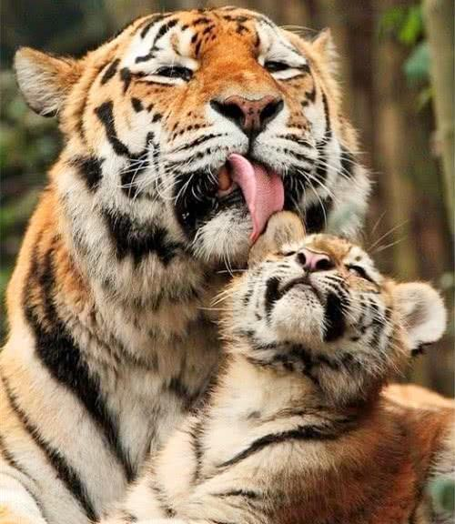
布老虎起源于虎图腾崇拜。
cloth tiger is actually a tiger worship.
虎毒不食子
even a vicious tiger will not eat its cubs

Slide 5
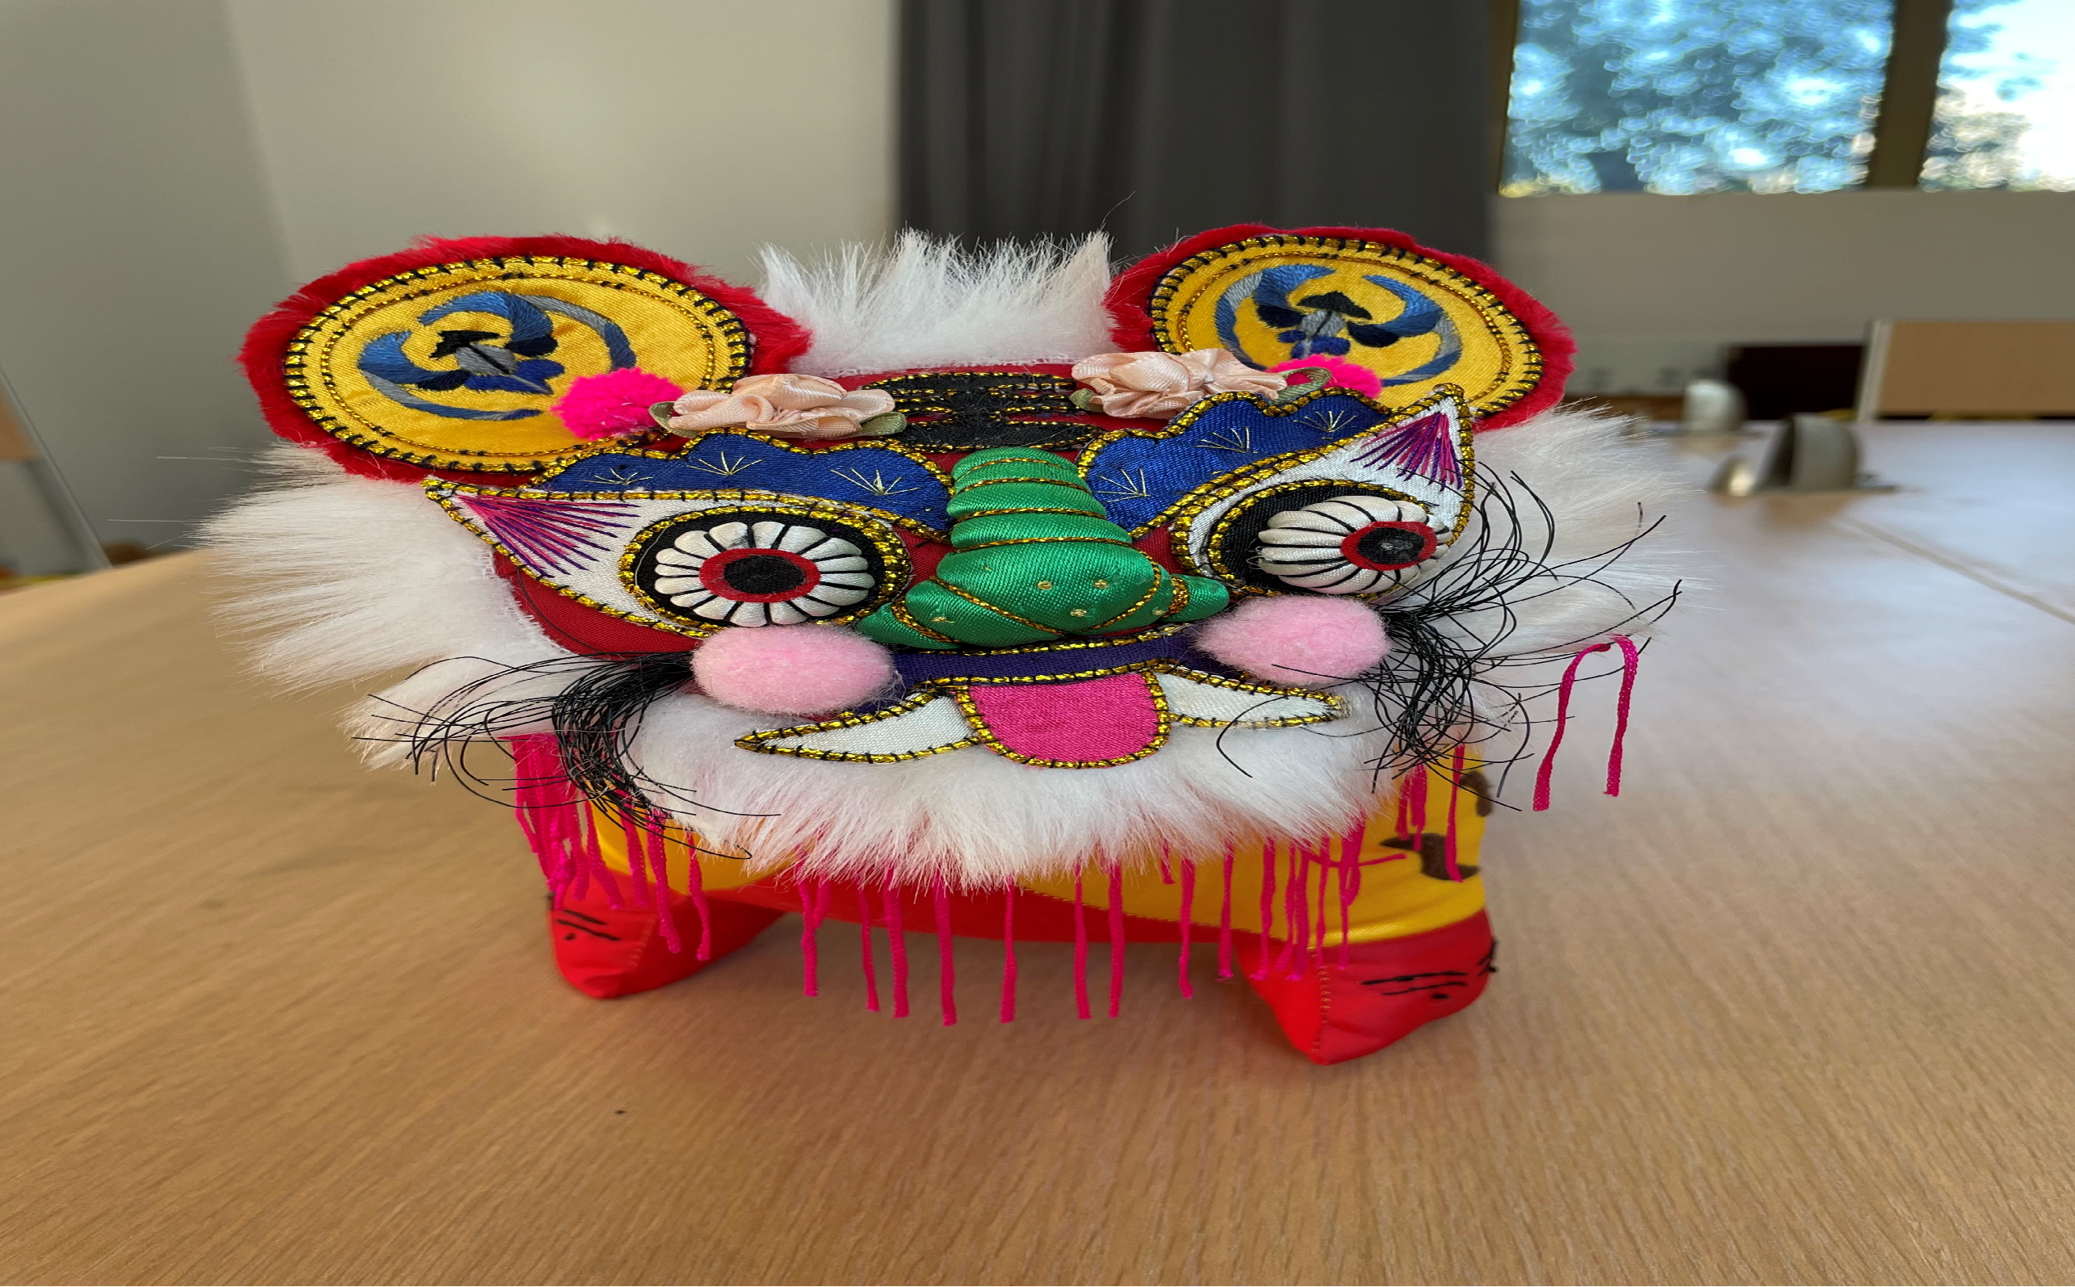
布老虎没有统一的标准，心灵手巧的妇女们用手中不同的材料，创造出了各不相同的布老虎。 There is no unified standard to make cloth tigers. Ingenious women use different materials to create various ones.

Slide 6
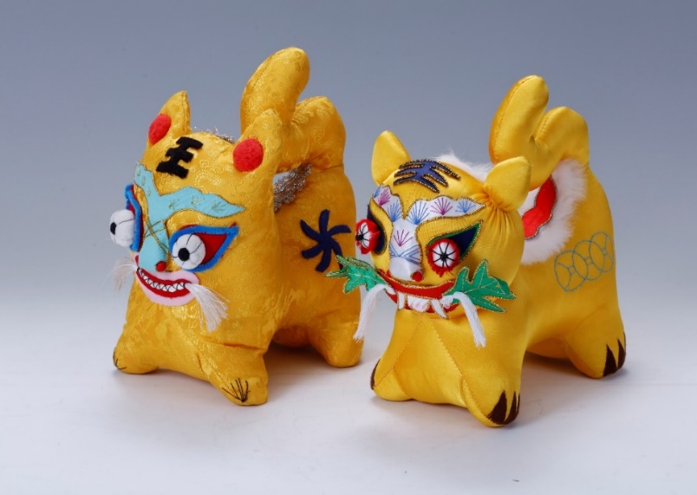
晋南虎
Jinnan tiger

Slide 7
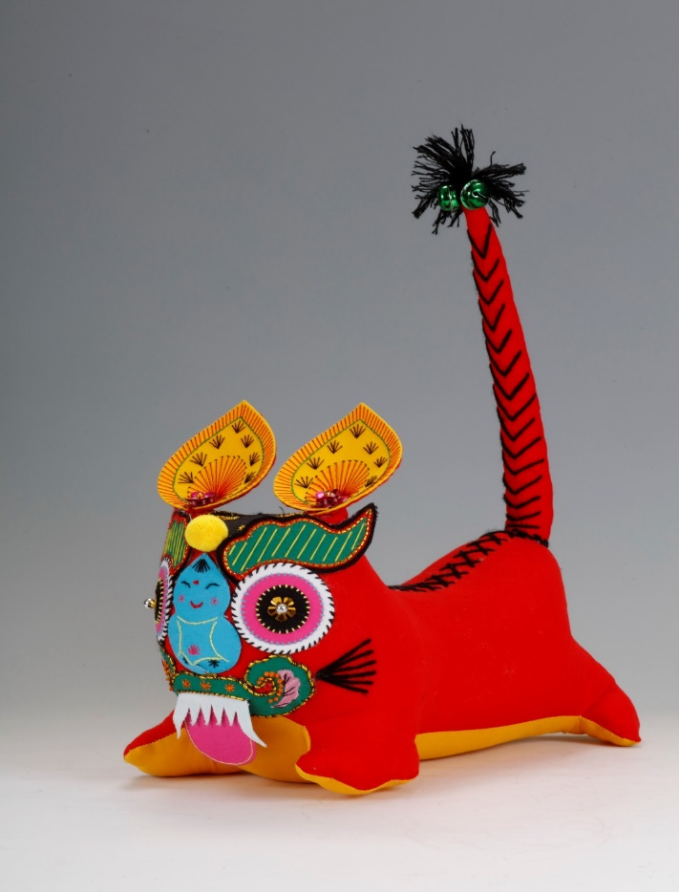
活尾虎
Huowei Tiger

Slide 8
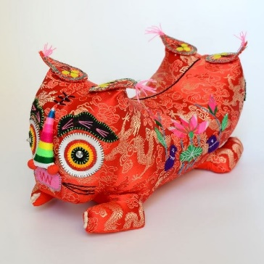
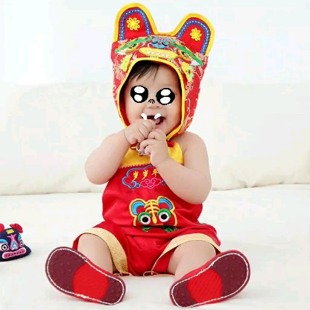
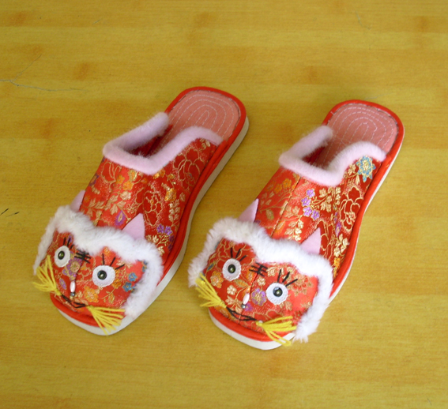
人们希望它们可以保护娃娃的平安，使娃娃远离厄运，健康幸福。 Tiger-head pillow, shoes as well as cap are the most common types. People expect they could protect their babies and drive away evils, and thus bring health and happiness.
虎头枕
tiger-head pillow
虎头帽
tiger-head cap
虎头鞋
tiger-head shoes

Slide 9
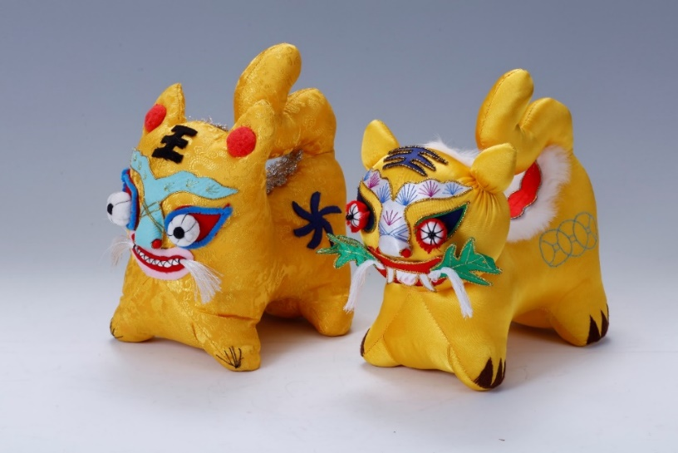
复习 review
Cloth Tiger from Shanxi Province
山西省的布老虎

Slide 10
复习 review
这是山西的晋南虎，它的鼻子是鱼鼻子，代表多子多孙。他的嘴里含着艾叶，寓意孩子可以躲避厄运，健康成长。
This is a jinnan tiger from Shanxi Province. Its nose is a fish nose, which means having many children . He has mugwort in his mouth, meaning children can avoid bad luck and grow up healthy.

Slide 11
谢谢观看！ Thank you！

